Slide 1

CUSTOMER CHURN PREDICTION USING SNOWFLAKE FEATURE ENGINEERING & MACHINE LEARNING
By : Alish Das
TOPICS: SNOWFLAKE | FEATURE ENGINEERING | FEATURE STORE | DATA PIPELINE | CHURN PREDICTION

Slide 2
BUSINESS OVERVIEW
WHY CHURN PREDICTION ?
  Subscription businesses (telecom, SaaS, banking) lose revenue due to customer churn.
  Churn prediction enables:
    Early identification of at-risk customers
    Targeted retention campaigns
    Improved customer lifetime value
    Data-driven business decisions
Objective: Building an end-to-end churn prediction pipeline on Snowflake using feature engineering and a feature store.

Slide 3
INTRODUCTION TO FEATURE ENGINEERING
  What is Feature Engineering?
Converting raw data into meaningful features that improve ML model
performance.
  Why is it Important?
  ML model success depends 80% on features, 20% on algorithms.
  Good features reduce model complexity and improve accuracy.
  Features enable consistent predictions across training and production.

Slide 4
COMMON FEATURE ENGINEERING TECHNIQUES:
  Normalization / Standardization (scaling numerical values)
  One-hot encoding (categorical variables)
  Time-based aggregations (rolling averages, lag features)
  Missing value treatment (imputation, removal)
  Binning (discretizing continuous variables)
  Feature scaling (min-max, z-score)

Slide 5
SNOWFLAKE FOR DATA STORAGE & PROCESSING
Snowflake's Role in the ML Pipeline
  Data Storage: Stores raw, structured, and semi-structured data in scalable tables.
  Data Processing: SQL-based data cleaning, validation, and aggregation.
  Integration: Seamless integration with Python (Snowpark) for ML workflows.
Benefits
  Centralized data governance
  Scalable compute (Snowflake warehouses)
  Native ML capabilities (Snowpark)

Slide 6
FEATURE STORE CONCEPTS
  What is a Feature Store?
A centralized repository to store, manage, and serve ML features for both training
and inference.
  Why do we need a feature store?
Consistency: Same features used during training and production.
Reusability: Features engineered once, used by multiple models.
Faster Development: Reduce redundant feature engineering across teams.
Offline/Online Access: Support batch training and real-time inference.

Slide 7
DATA PIPELINE FLOW:
Raw Data (CSV) → Snowflake
Raw Table (RAW_CUSTOMERS)
Data Cleaning (CLEANED_CUSTOMERS)
Feature Engineering (CUSTOMER_FEATURES = Feature Store)
Train/Test Split (TRAIN_CUSTOMERS, TEST_CUSTOMERS)
Rule-based Scoring (Snowpark Python)
Predictions (CHURN_PREDICTIONS)
Downstream (Dashboards, CRM, Business Actions)

Slide 8
SNOWFLAKE ENVIRONMENT SETUP
  Created Snowflake free trial account on Amazon AWS.
  Initialized COMPUTE_WH warehouse (X-Small compute layer).
  Created CUSTOMER_DB database with PUBLIC schema.
  Uploaded customer churn CSV file into RAW_CUSTOMERS table.
RAW_CUSTOMERS Table Schema:
  CUSTOMER_ID (INT)
  TENURE (INT) – months with company
  MONTHLY_CHARGES (FLOAT)
  SUPPORT_CALLS (INT)
  DATA_USAGE (FLOAT)
  PLAN_TYPE (STRING)
  PAYMENT_METHOD (STRING)
  LAST_RECHARGE (DATE)
  CHURN (STRING) – Yes/No label
Result: 500 customer records loaded and ready for processing.

Slide 9
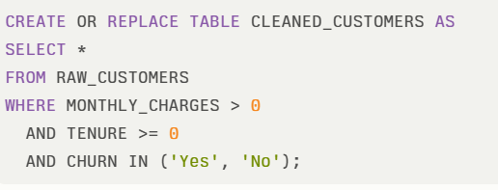
DATA VALIDATION & CLEANING
Data Quality Checks Performed:
  Null values in critical fields (tenure, charges, churn label)
  Invalid charges (negative or zero values)
  Invalid tenure (negative values)
  Invalid churn labels (not 'Yes' or 'No')
  Duplicate records based on CUSTOMER_ID
Cleaning SQL:
Result: 500 rows validated; invalid records removed; clean dataset ready for feature engineering.

Slide 10
FEATURE ENGINEERING IMPLEMENTATION
Customer Behavior:
  TENURE – months of relationship
  MONTHLY_CHARGES – subscription cost
  SUPPORT_CALLS – calls to support (count)
  DATA_USAGE – monthly data consumption
Time-Based Features:
  DAYS_SINCE_RECHARGE – days since last payment
  TENURE_GROUP – categorical (NEW: <6mo, MID: 6-12mo, OLD: >12mo)
Target Variable:
  CHURN_LABEL – 1 if churned, 0 otherwise

Slide 11
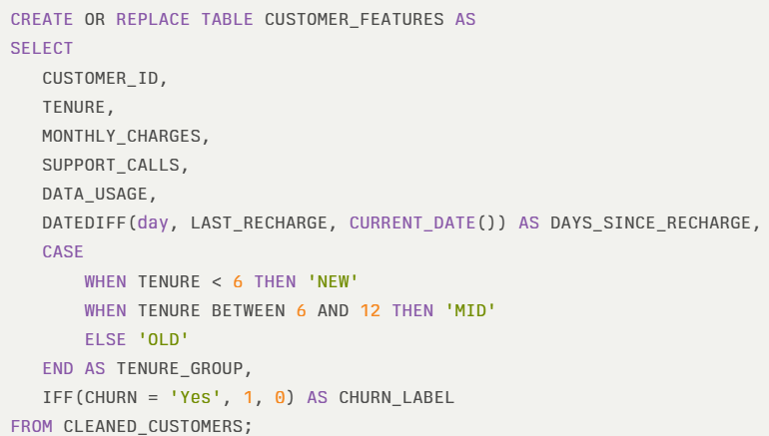
FEATURE ENGINEERING SQL

Slide 12
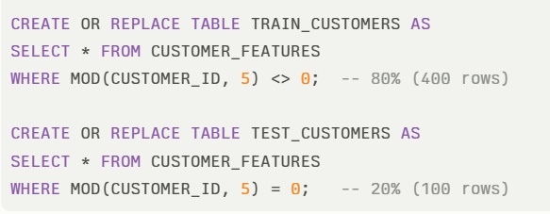
TRAIN-TEST SPLIT & DATA PREPARATION
Result:
TRAIN_CUSTOMERS: ~400 customers (model learns patterns)
TEST_CUSTOMERS: ~100 customers (model evaluation)
Both tables contain all engineered features + CHURN_LABEL

Slide 13
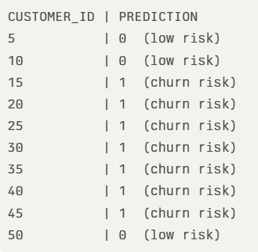
PREDICTIONS & RESULTS
Interpretation:
  PREDICTION = 1 → Customer flagged as high churn risk
  PREDICTION = 0 → Customer flagged as low risk
  Actions: Target high-risk customers with retention offers
Business Value:
  CRM teams access predictions for targeted campaigns
  Dashboards visualize churn distribution by segment
  Sales alerts identify at-risk accounts

Slide 14
CONCLUSION
Feature Engineering Pipeline:
✅Transformed raw customer data into 8 meaningful features
✅ Feature Store: CUSTOMER_FEATURES table serves as centralized feature repository
✅ Data Pipeline: Raw → Clean → Features → Train/Test → Predictions
✅ In-Database ML: Rule-based churn scoring implemented using Snowpark Python
✅ Production Ready: Predictions stored back in Snowflake for dashboards & CRM

Slide 15
THANK
YOU

